Slide 1
Linux System Administration
LINUX SYSTEM ADMINISTRATION

Slide 2
SYS ADMIN TASKS
Linux System Administration
Setting the Run Level
System Services
User Management
Network Settings
Scheduling Jobs
Quota Management
Backup and Restore
Adding and Removing software/packages
Setting a Printer
Monitoring the system (general, logs)
Monitoring any specific services running. Eg. DNS, DHCP, Web, NIS, NPT, Proxy etc.

Slide 3
Init Runlevels
Linux System Administration
The following runlevels are defined in Linux:
  0 - halt (Do NOT set initdefault to this)
  1 - Single user mode
  2 - Multiuser, without Network (The same as 3, if
  you do not have networking)
  3 – Text Mode
  4 - unused
  5 – Graphical Mode
  6 - reboot (Do NOT set initdefault to this)

Slide 4
Init Runlevels
Desktop Configuration
The default runlevel for a system to boot to is configured in /etc/inittab.
  id:5:initdefault:
In GUI: Applications → System Settings → Server Settings→ Services
Generally, Linux operates in runlevel 3 or 5.

Slide 5
Linux Services
Linux System Administration
There are 113 deamons, Out of them, the following are most widely used:
apmd : Power Management
autofs : Automount services
crond : Periodic Command Scheduler
cups : Common Unix Printing System
dhcpd : The DHCP server
dovecot : IMAP (Internet Message Access Protocol) and POP3 (Post Office Protocol) server
gpm : Mouse
httpd : Apache Web server

Slide 6
Linux Services
Linux System Administration
iptables : Kernel based Packet Filtering firewall
kudzu: Finds new Hardware
mysqld : MySQL server
named : BIND server
network : Networking
nfs : Network File Share
nfslock : NFS file locking
ntpd : NTP (Network Time Protocol) server
portmap : RPC (Remote Procedure Call) support
postgresql : The Postgresql Database Engine

Slide 7
Linux Services
Linux System Administration
sendmail : Sendmail Mail Server
smb : Samba Network Services
snmpd : Simple Network Management Protocol
squid : Squid Proxy Server
sshd : Open SSH and SFTP server
syslog : System Logging
xinetd : Provides support for telnet, ftp, talk, tftp etc.
ypbind : NIS Server

Slide 8
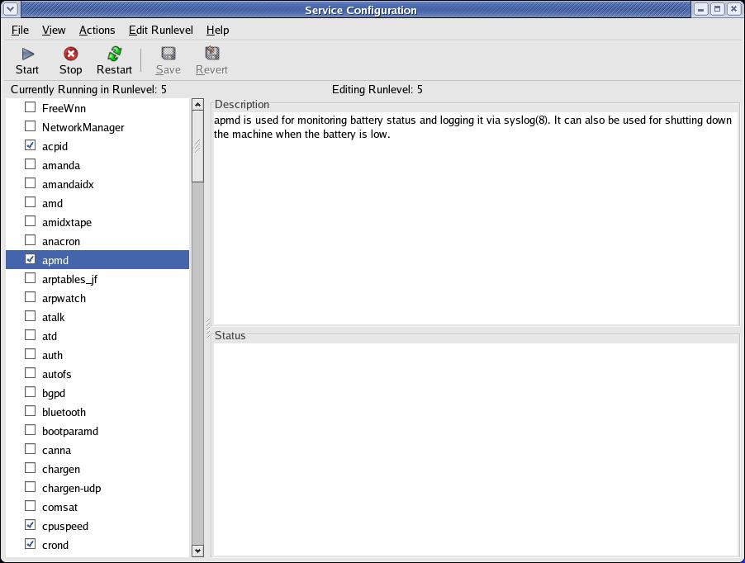

Slide 9
Linux Services
Linux System Administration
Start/Stop boot time services in /etc/rc.d/rc3.d or /etc/rc.d/rc5.d
All services startup scripts which start with S will start at boot time and all startup scripts which start with K will not start at boot time. The number after S or K is the priority.
    K95kudzu
    K96pcmcia
    S56xinetd
    S60vsftpd
Use
service <service name> start/stop/restart
to start, stop or restart a service from command line

Slide 10
Creating a new User Account
Linux System Administration
Add an entry in /etc/passwd and /etc/shadow file (use next uid and suitable gid). You will have to create the user directory and assign a password to the user
Use useradd or adduser command to create a new user (useradd –g <group> -d <home directory> -c <comment> -s <shell> login-name) and groupadd to create a new group (groupadd group-name). You will have to assign a password (passwd login-name)
In GUI: Applications → System Settings → Users and Groups

Slide 11
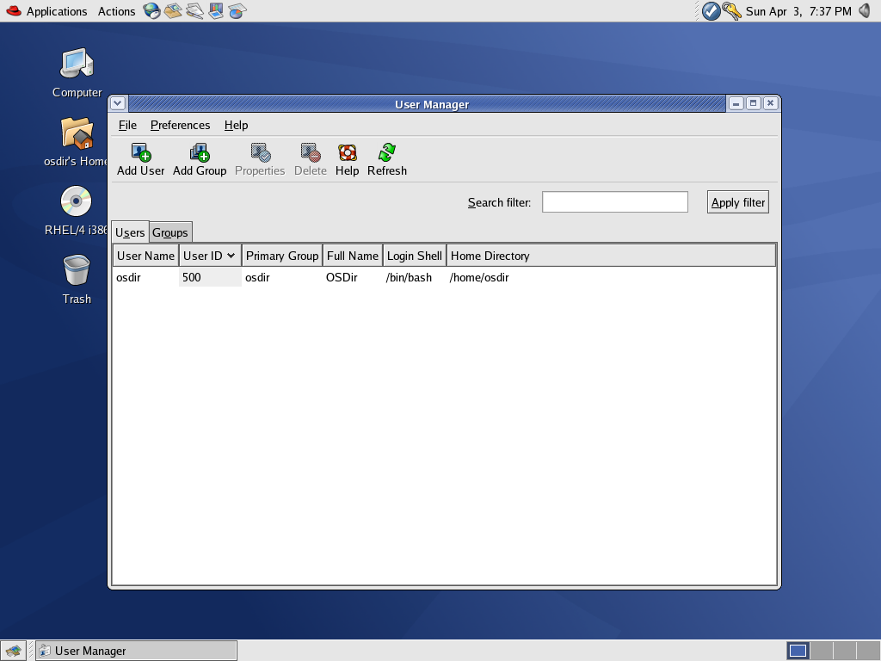

Slide 12
/etc/passwd File
Linux System Administration
/etc/passwd Holds user account info
Included fields are:
  Login name
  User Id (uid)
  Group Id (gid)
  General Comment about the user
  Home Directory
  Shell

Slide 13
/etc/shadow File
Linux System Administration
/etc/shadow Contains the encrypted password information for users' accounts and optionally the password aging information. Included fields are:
  Login name
  Encrypted password
  Days since Jan 1, 1970 that password was last changed
  Days before password may not be changed
  Days after which password must be changed
  Days before password is to expire that user is warned
  Days after password expires that account is disabled
  Days since Jan 1, 1970 that account is disabled

Slide 14
Suspending a User Account
Linux System Administration
Put a * as start of Password field in /etc/shadow
Change login shell to /sbin/nologin
Use GUI to suspend the user

Slide 15
Removing a User Account
Linux System Administration
Remove login id from /etc/passwd & /etc/shadow file and delete home directory
userdel –r <username>
Use GUI to Delete the user

